Slide 1
It’s Time for New Thinking New Ways

Slide 2
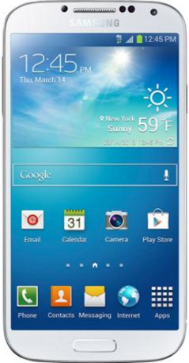
This is how we do life now.

Slide 3
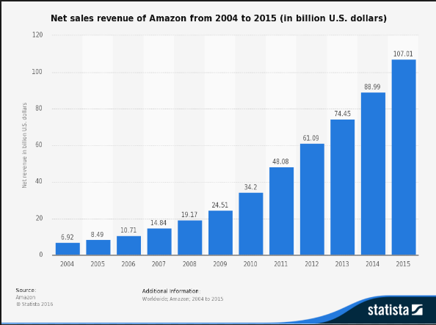
Amazon sales

Slide 4
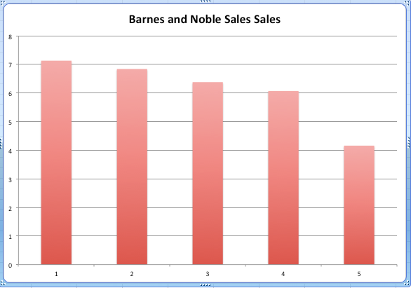
Barnes & Noble sales

Slide 6
Is God real? Is Jesus God? Will God help me with this addiction?

Slide 7
If not already connected to a church, they are not likely to drive to a church, find a pastor, and ask these questions. You know who they’re going to ask?

Slide 9
Why? It’s private. Fast. At the moment of need. No effort.

Slide 10
It’s private. Fast. At the moment of need. No effort.

Slide 11
private fast at moment of need no effort

Slide 12
When people have questions about God, many don’t want a debate or an intimate conversation about it.

Slide 13
Many want to explore their spiritual questions on their own.

Slide 14
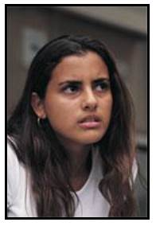
Many are not sure what they believe, and are embarrassed they don’t know more.

Slide 15
Online is comfortable. Safe. They are in control. No one is challenging them. Defenses can come down. They can be honest.

Slide 16
“If your God exists, I wonder if he would care about me. I’ve done some pretty stupid stuff in my life. My thoughts are that he would look my way in disdain and complete and utter disappointment.”

Slide 17
We need to adjust, to offer our message in a way that people want to receive it. (a basic marketing principle)

Slide 18
How did Paul do it? “To the Jews I became as a Jew, in order to win Jews. To those under the law… To those outside the law... To the weak I became weak... I have become all things to all people that by all means I might save some.”

Slide 19
If we want a strong ministry, we need to serve people on their terms.

Slide 20
You lead someone to Christ, and say... “Let’s get together in a few days, because I have some really important information to share with you.”

Slide 21
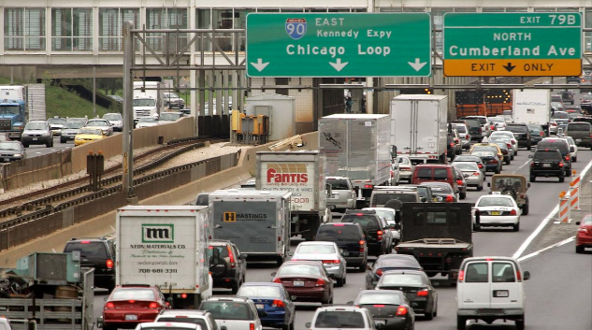
They’re thinking… “Drive, to meet you, in order to get some information?”

Slide 22
“Can’t you just text me a link?”

Slide 23
Does this mean we can’t talk to people anymore?!!

Slide 24
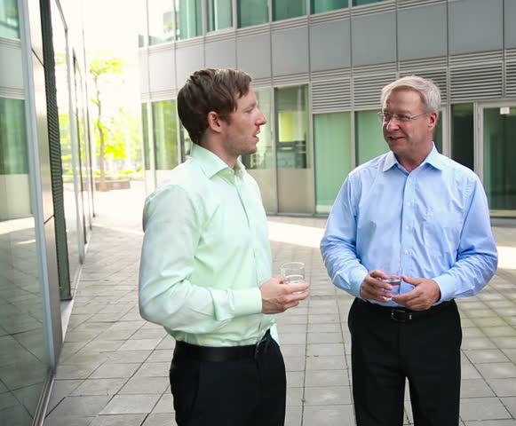
Just the opposite! This opens so many more conversations!!

Slide 25
Conversations about God that are comfortable for both you and them.

